Slide 1


Presentation
on
phishing attacks
by: Paul Owolabi
Intern @CodeAlpha

Slide 2
CONTENTS
Introduction to Phishing
Recognizing Phishing Emails and Fake Websites
1
Definition of phishing.
Types of phishing attacks
The growing impact and statistics around phishing globallyhits
2
Warning signs of phishing emails
Identifying fake login pages and HTTPS vs HTTP.
How to analyze email headers and inspect links before clicking
Understanding Social Engineering Tactics
Best Practices to Stay Safe
3
4
Never click on suspicious links
Use multi-factor authentication (MFA).
Regularly update software and antivirus tools.
Verify email sender etc
Overview of social engineering and how it relates to phishing.
Common tactics: pretexting, baiting, tailgating& impersonation.
Real-world examples and interactive quizzes
5
Twitter Hack (2020):
Sony Pictures Hack (2014):
Google & Facebook Scam (2013–2015):
interactive quizzes

Slide 3

1
Introduction to Phishing
Definition of phishing
Phishing is a type of cyberattack where attackers impersonate legitimate sources (like banks, companies, or colleagues) to trick individuals into revealing sensitive information such as passwords, credit card numbers, or login credentials. It usually occurs through email, messages, or fake websites.

Slide 4
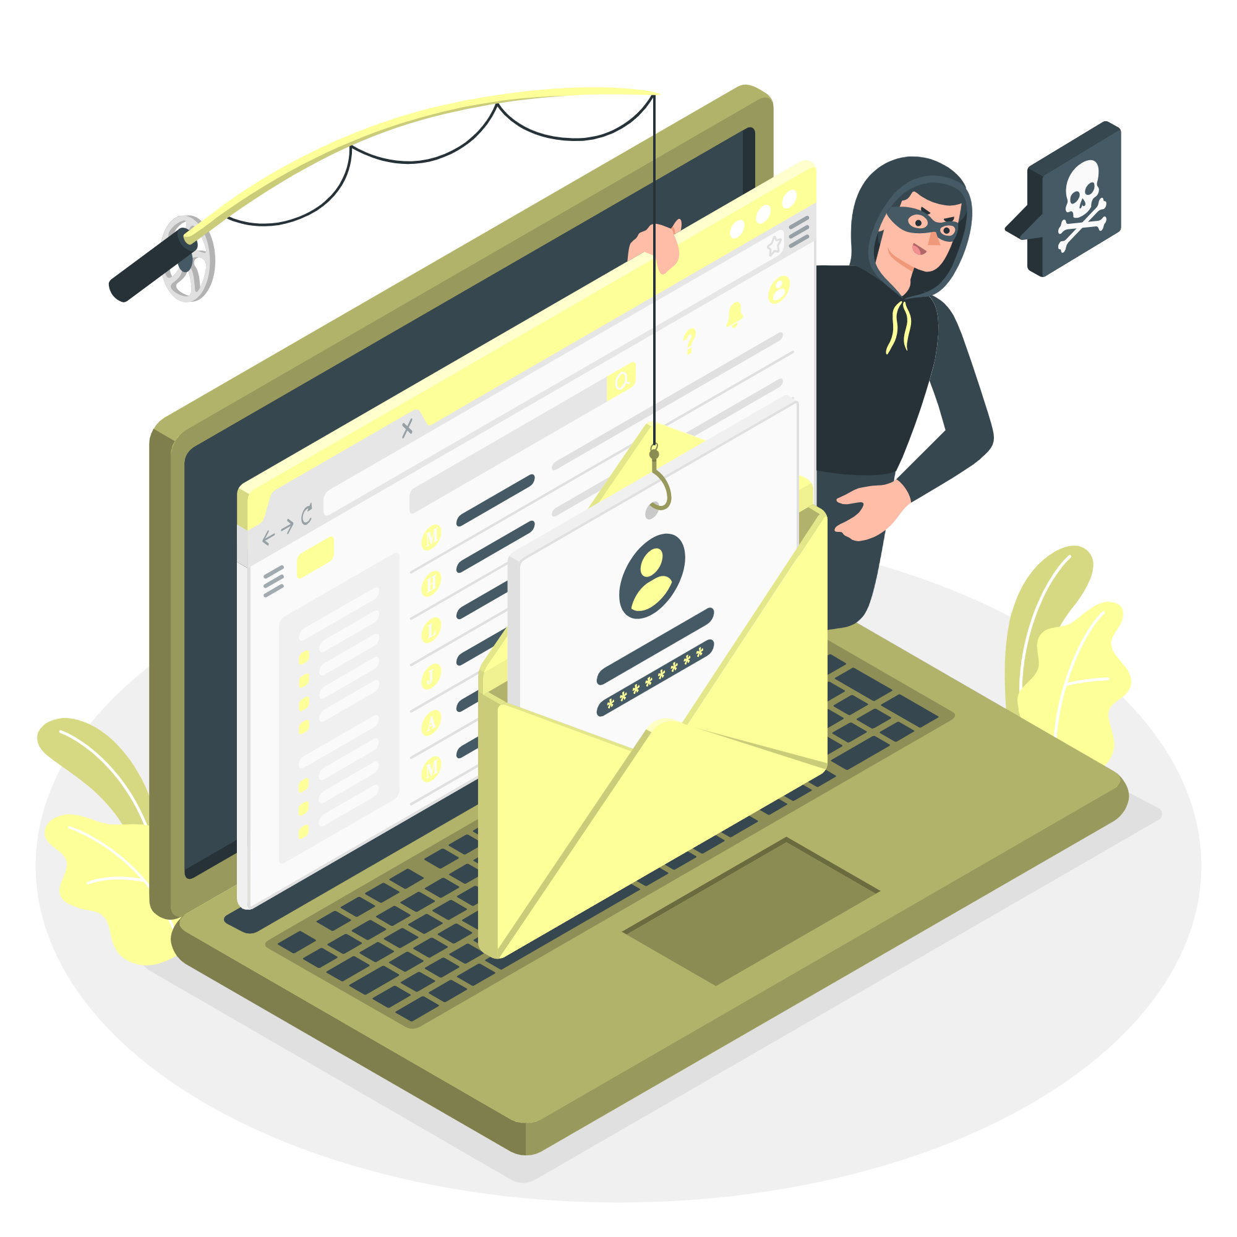
Types of Phishing Attacks
Email Phishing:
Smishing (SMS Phishing):
The most common form where attackers send deceptive emails that appear to come from trusted sources to steal information or install malware
Fraudulent messages sent via SMS/text, often containing malicious links or urgent requests zfor information
Add your title
Spear Phishing:
Pharming:
A targeted version of phishing aimed at specific individuals or organizations, using personal information to make the attack more convincing.
Redirecting users from legitimate websites to fake ones without their knowledge, often through malware or DNS poisoning
Vishing (Voice Phishing):
Attackers use phone calls pretending to be from banks, tech support, or government agencies to trick victims into giving out information

Slide 5

The Growing Impact and Statistics Around Phishing Globally
Phishing attacks account for over 80% of reported security incidents worldwide.
According to cybersecurity reports, 1 in every 99 emails is a phishing attempt.
The global cost of phishing attacks exceeded $12 billion in losses over recent years.
Attackers are increasingly using AI tools and social engineering to craft more convincing phishing messages.
Remote work and digital reliance have increased the frequency and success rate of phishing attempts.

Slide 6

2
Recognizing Phishing Emails and Fake Websites
Warning Signs of Phishing Emails
Mismatched URLs:
Hover over links to check the actual URL. If it doesn’t match the sender or looks strange, it’s likely phishing.
Grammar/Spelling Errors:
Legitimate companies rarely send emails with poor grammar or spelling mistakes.
Suspicious Attachments:
Unexpected files (especially .exe, .zip, or .scr) may contain malware.
Urgent or Threatening Language:
Phrases like “Your account will be closed!” or “Immediate action required!” are used to create panic and rush decisions

Slide 7

Identifying Fake Login Pages & HTTPS vs HTTP
Fake Login Pages:
Often look very similar to real ones but have unusual URLs or design flaws. Always check the URL before entering your details.
HTTPS vs HTTP:
Secure sites use HTTPS (with a padlock icon). Avoid entering information on sites that use HTTP — they’re not secure.
How to Analyze Email Headers & Inspect Links
Email Headers:
Check the "From" address and return path. Phishing emails may show a known name but use a different, suspicious domain.
Inspecting Links:
Hover over links (don’t click!) to preview the actual destination. If it looks unfamiliar or unrelated, it’s best to avoid.

Slide 8
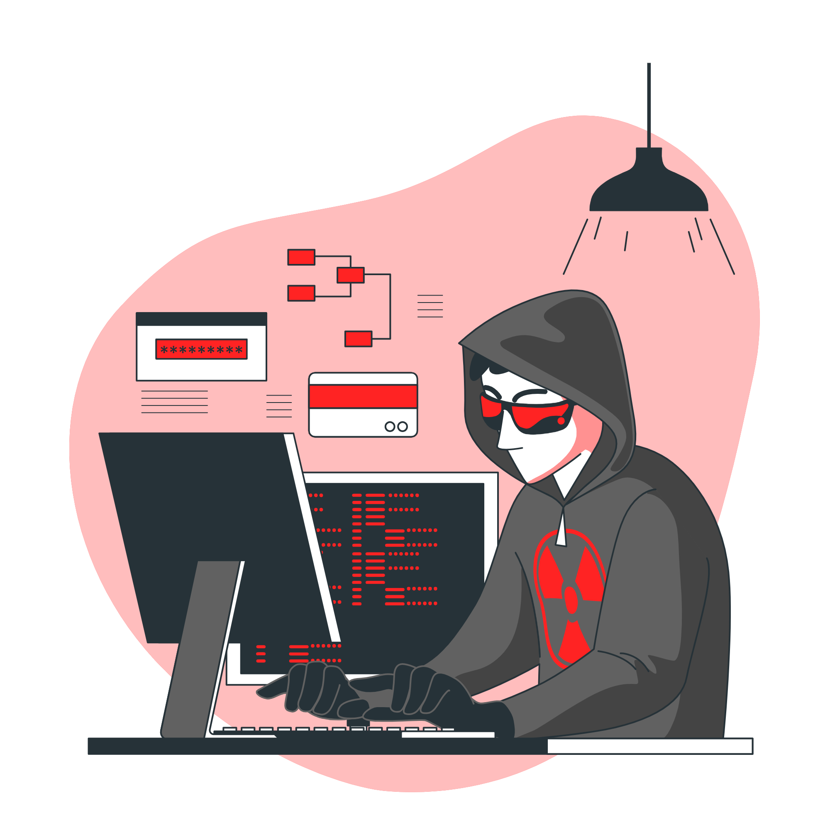
3
Understanding Social Engineering Tactics
Overview of Social Engineering & Its Link to Phishing
Social Engineering is the use of psychological manipulation to trick people into giving up confidential information or performing harmful actions.
Phishing is a common form of social engineering, where attackers pretend to be trusted sources (via email, SMS, or calls) to exploit human trust and curiosity.

Slide 9

Common Social Engineering Tactics
Pretexting:
Baiting:
Attacker creates a fake scenario (e.g., pretending to be IT support) to gain trust and extract information.
Entices the victim with something appealing (e.g., free downloads, USB drives) that contains malware
Tailgating:
Impersonation:
Gaining physical access by following an authorized person into a secure area without credentials.
Pretending to be someone trusted (like a manager or colleague) to request sensitive actions or information.

Slide 10
4
Best Practices to Stay Safe from Phishing
Never Click on Suspicious
Verify Email Senders
Always double-check links and files before opening. Malicious links can install malware or steal your data
Don’t trust display names alone. Check the full email address and report anything that seems off to your IT/security team
Use Multi-Factor Authentication (MFA)
Educate Yourself Continuously
Adds an extra layer of security beyond just a password—such as a code sent to your phone or an authentication app.
Stay informed through trusted cybersecurity blogs, training, or alerts. Attack tactics evolve regularly.
Regularly Update Software
Keep systems and security tools up to date to fix known vulnerabilities that attackers might exploit

Slide 11
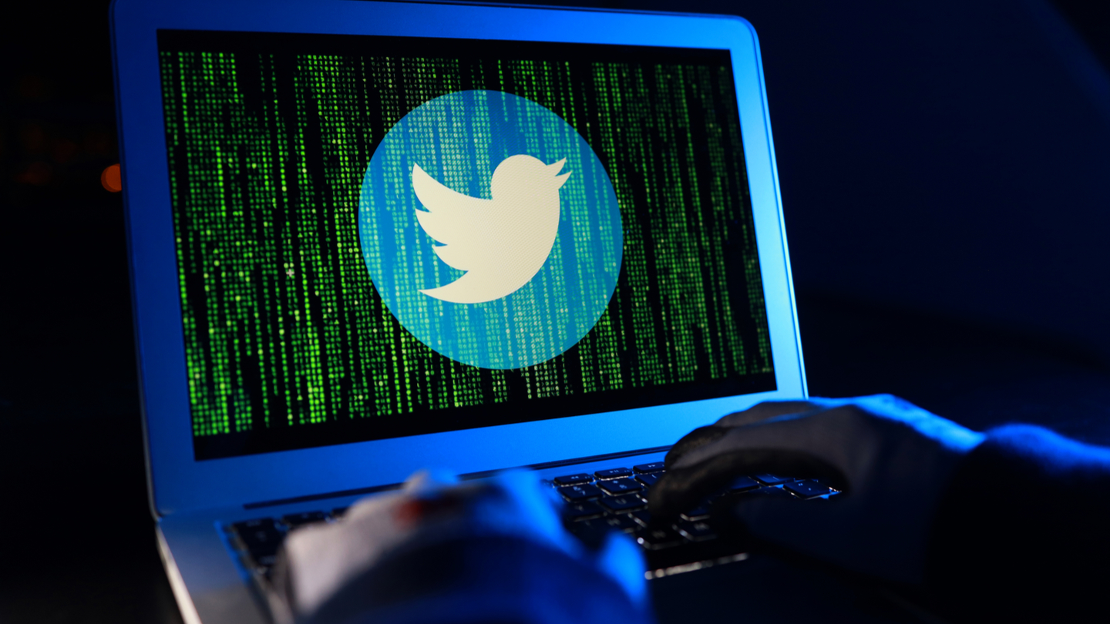

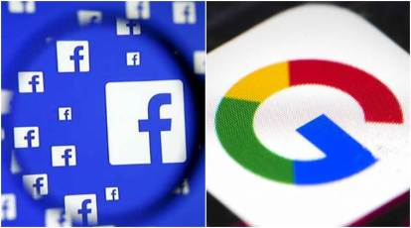
5
Real-world examples and interactive quizzes
Twitter Hack (2020)
Sony Pictures Hack (2014)
Google & Facebook Scam
(2013–2015)

Slide 12
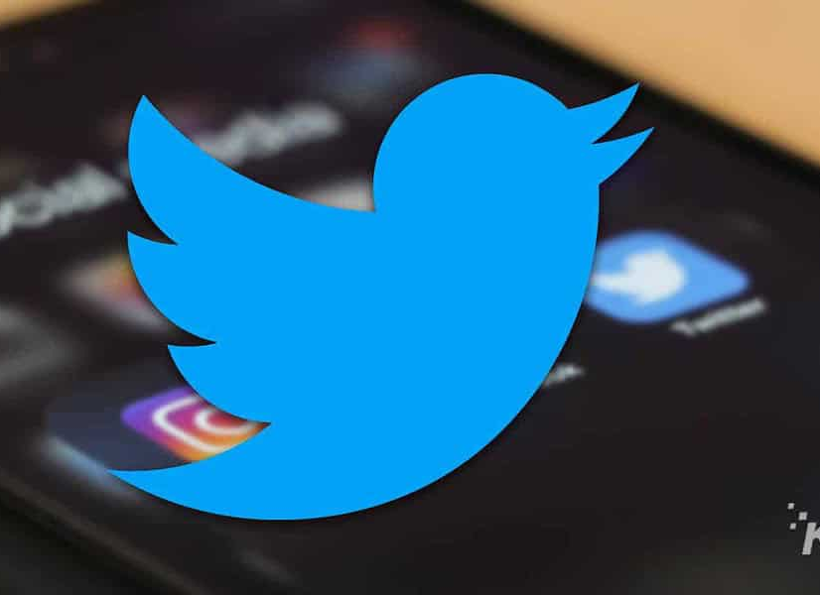
Twitter Hack (2020)
In July 2020, Twitter experienced a major security breach where the accounts of high-profile individuals and companies — including Barack Obama, Elon Musk, Bill Gates, Apple, and Uber — were hijacked. The attackers used social engineering and phishing techniques to target Twitter employees who had access to internal tools.
The attackers tricked employees into logging into a fake corporate login page, capturing their credentials. Once inside, they exploited Twitter’s administrative tools to reset email addresses and passwords for major accounts. These compromised accounts were then used to post Bitcoin scam messages, urging followers to send cryptocurrency with a false promise of doubling their money.
This attack exposed the vulnerability of internal systems to human error, even in large tech companies. It also highlighted the need for stronger internal controls, employee awareness training, and multi-factor authentication for critical system access.

Slide 13
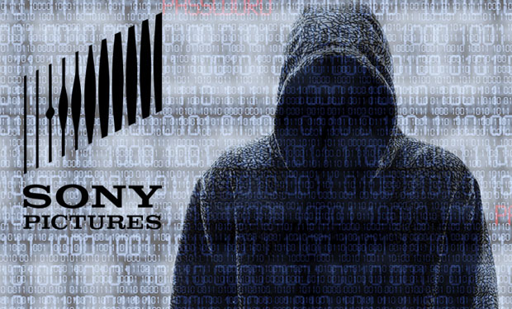
Sony Pictures Hack (2014)
While largely known as a cyber-espionage operation, the infamous 2014 Sony Pictures hack had its roots in phishing. The attackers — a group calling themselves the Guardians of Peace (GOP) — reportedly gained entry to Sony's internal systems by sending phishing emails to employees, convincing them to click malicious links or attachments that installed malware or captured login credentials.
Once inside the network, the attackers spent months gathering sensitive data, which included unreleased films, confidential emails, employee records, and financial documents. They eventually wiped company servers and published the stolen information online. The attack was believed to be in retaliation for Sony’s film “The Interview”, a satire of North Korea’s leader Kim Jong-un. The U.S. government attributed the attack to North Korea.
This incident remains a significant example of how targeted phishing can be the gateway to large-scale, politically motivated cyberattacks. It caused massive financial loss, reputational damage, and forced Sony to temporarily shut down its entire IT infrastructure.

Slide 14
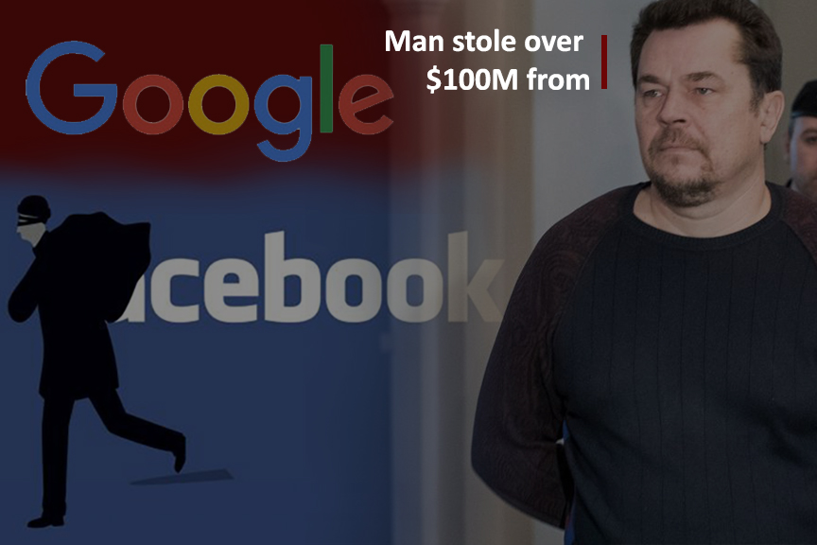
Google & Facebook Scam (2013–2015)
Between 2013 and 2015, a Lithuanian man named Evaldas Rimasauskas managed to steal over $100 million from tech giants Google and Facebook through a sophisticated phishing and business email compromise (BEC) scam.
He created a fake company that impersonated Quanta Computer, a real Taiwanese hardware supplier. Then, using spoofed email addresses, fake invoices, and fraudulent contracts, he tricked employees at both companies into authorizing large payments to accounts he controlled. The phishing emails were highly convincing and tailored to appear as routine vendor communications.
What makes this case especially striking is that it bypassed traditional technical defenses — relying purely on deception, fake documentation, and procedural manipulation. Both companies eventually recovered the funds after working with law enforcement, but the attack showed how even the most advanced organizations can fall victim to well-crafted phishing schemes.

Slide 15
quizzes
1. What is the main goal of a phishing attack?
A) To entertain the victim
B) To promote a product
C) To trick the victim into revealing sensitive information
D) To send friendly messages
2. Which of the following is a sign of a phishing email?
A) Professional formatting
B) Mismatched or suspicious URLs
C) Personalized greeting with your full name
D) Secure sender address
3. What should you do if you receive a suspicious email from a known contact?
A) Reply and ask for clarification
B) Click the link quickly before it expires
C) Report the email and verify through another method
D) Forward it to others to ask if it’s real
4. What does HTTPS in a website URL indicate?
A) It is a free website
B) It is not safe
C) It has a secure connection
D) It will contain phishing content
5. Which tactic involves an attacker pretending to be someone trustworthy?
A) Baiting
B) Pretexting
C) Impersonation
D) Tailgating
6. Which of the following is an example of vishing?
A) Sending a fake website link via email
B) Calling someone while pretending to be tech support
C) Sending a malicious file through a messaging app
D) Creating a fake login page to steal credentials

Slide 16
True/False Questions
7. It is safe to open attachments if the email comes from someone you know.
8. Multi-Factor Authentication (MFA) makes it harder for attackers to access your accounts.
9. You should hover over a link before clicking to see the real destination.
10. Once a phishing email is reported, there is no need to educate users further.
12. Social engineering is a technical attack that doesn’t involve human interaction.

Slide 17
Answers to quiz
✅ Correct Answer: C
✅ Correct Answer: B
✅ Correct Answer: C
✅ Correct Answer: C
✅ Correct Answer: C
✅ Correct Answer: B
❌ False – Attackers can spoof email addresses.
✅ True
✅ True
❌ False – Ongoing training is essential.
❌ False – It heavily relies on manipulating human behavior.

